Slide 1

Ethical Considerations When Starting New Chapters
Ikenna Okoro
Okoro Law, PLLC
Notes:
Hello
My name is Ikenna Okoro and I am the Founder of Okoro Law
I will tell you more about me in a second. But before we dive in, I’d like to get to know you all a little bit.
So show of hands, how many of you have only had one employer since graduating law school?
Ok, how many of you have worked at at least 3 law firms, companies, or agencies since graduating law school?
Wow, that’s most of the room.
Ok how many of you are planning your next job right now?

Slide 2
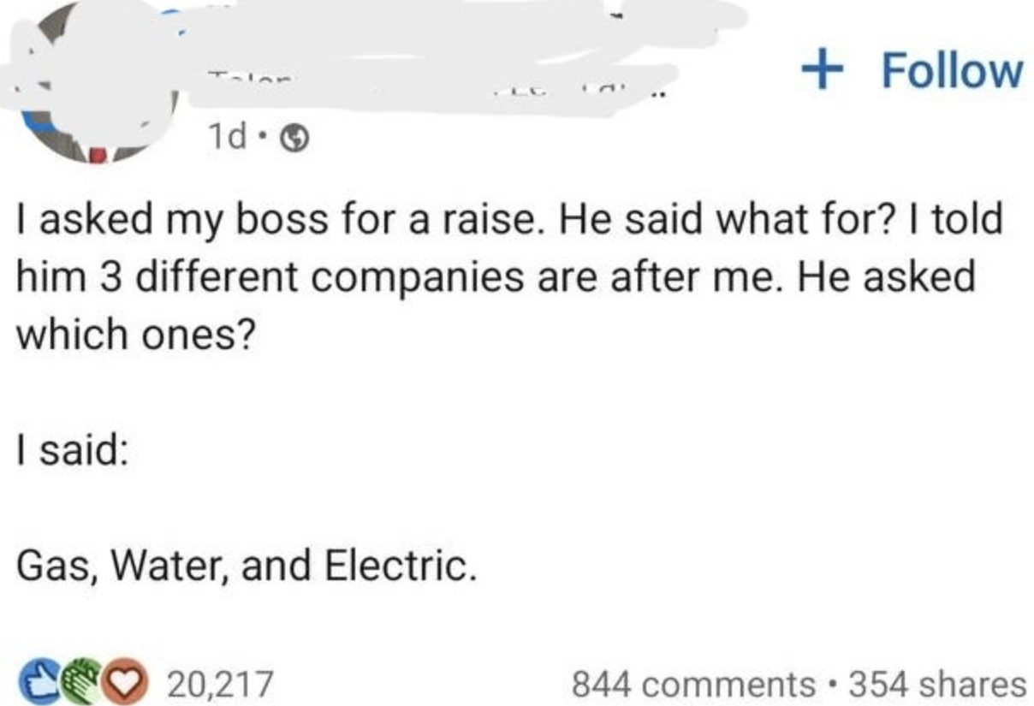
Job Changes Within the Legal Profession
40% of legal professionals are considering a new job.
The government sector increased its hiring for legal roles by 73% compared to the previous year.
1% unemployment rate for lawyers (national unemployment rate of 3.8% for March 2024).
2024 Demand for Skilled Talent report by Robert Half
Notes:
So as we can see from that exercise, job changes within the legal profession is a common occurrence. According to a recent study by a hiring and staffing firm…
The primary reason for this trend is the increased earning potential in changing firms, although other reasons were cited in a 2018 survey by Robert Half Legal. Work-life balance, career autonomy and advancement potential as other top reasons for their changes
But regardless of the reason, it seems almost guaranteed that a lawyer will practice law at a few places throughout their career

Slide 3

My Chapters
2019
Graduated from The University of Texas School of Law
2019–2022
Assistant Parliamentarian for the Texas House
2022–2024
Associate & Lobbyist at Balch & Bingham
April 2024 – Present
Founder of Okoro Law
How it started:
How it’s going:
Notes:
So I know some of you are wondering who I am and how I got up here so let me explain,

Slide 4
Overview
Duties and considerations when a lawyer changes jobs:
  Chapter 1: From One Firm to Another Firm
  Chapter 2: From a Firm to the Public Sector
  Chapter 3: From the Public Sector to the Private Sector
Notes:
This presentation will not cover involuntary reasons for terminating a practice
13.01 Notice of Attorney's Cessation of Practice; Texas Rules of Disciplinary Procedure
1.15 – lawyer fitness to practice
https://www.legalethicstexas.com/resources/rules/texas-rules-of-disciplinary-procedure/notice-of-attorneys-cessation-of-practice/

Slide 5
Presentation Terminology & Governing Rules
Texas Disciplinary Rules Of Professional Conduct (Tex DRPC) (with emphasis added)
"Firm" or "Law firm" denotes a lawyer or lawyers in a private firm; or a lawyer or lawyers employed in the legal department of a corporation, legal services organization, or other organization, or in a unit of government.
Notes:
Any references to rules are from the TDRPC
DRPC defines Firm or Law firm as….
Because we will be making the distinction between government and private sector positions. If I use firm or law firm that is a reference to a private sector position and not a government agency.

Slide 6

Notes:
So I think I also could have named this presentation ethical considerations before making a cringe LinkedIn update

Slide 7
Chapter 1: From One Firm to Another Firm
On Monday, Sam announces he is leaving his firm Old & Associates to join New Law Firm, PC that Friday.
He copies several company files (including client files of cases that he did not work on).
The managing partner argues that Sam’s employment agreement requires him to provide 60 days written notice and prevents him from copying client files.
Sam plans to use an identical legal services agreement for the clients that follow him.
Notes:
Let’s explore this fact pattern

Slide 8
Rule 1.01(b)
(b) In representing a client, a lawyer shall not:
  (1) neglect a legal matter entrusted to the lawyer; or
  (2) frequently fail to carry out completely the obligations that the lawyer owes to a client or clients.
Notes:
So the first rule governing the client-lawyer relationship states that ….
So as a component of being a zealous advocate for clients. There is an implied expectation that a lawyer will carry out their obligations for a client until the matter has been resolved.
The notes for this rule also mention the the significance of time when representing a client and how the passage of time can adversely effect a client’s case and “can cause a client needless anxiety and undermine confidence in the lawyer's trustworthiness”. Thus it is a lawyer’s responsibility to to communicate reasonably with clients to prevent adverse issues or this anxiety if any delays or interruptions are expected.

Slide 9
Rules 1.02 and 1.15
Tex DRPC 1.02
  A lawyer must abide by a client’s decision concerning the objectives and general methods of representation
Tex DRPC 1.15 (d)
  Upon termination of representation, a lawyer shall take steps to the extent reasonably practicable to protect a client's interests, such as giving reasonable notice to the client, allowing time for employment of other counsel, surrendering papers and property to which the client is entitled and refunding any advance payments of fee that has not been earned. The lawyer may retain papers relating to the client to the extent permitted by other law only if such retention will not prejudice the client in the subject matter of the representation.
Notes:
So essentially, Rules 1.02 highlights the autonomy and decision making ability that clients have and must maintain throughout their legal representation.
So like we discussed earlier, A lawyer should not accept representation in a matter unless it can be performed competently, promptly, and without improper conflict of interest. So the comments for 1.15 state that , a lawyer normally should endeavor to handle the matter until it has been resolved. Nevertheless, in certain situations the lawyer must terminate the representation and in certain other situations the lawyer is permitted to withdraw.
So leaving a law firm interrupts the service of a client, so Rule 1.15 gives us guidance on how to ensure that a client can still achieve the support to have it's matter resolved by an attorney without interruption. In other words, how can you hand off the clients matter to another attorney to ensure seamless representation.

Slide 10
Rule 5.06(a)
“[a] lawyer shall not participate in offering or making ... a partnership or employment agreement that restricts the rights of a lawyer to practice after termination of the relationship, except an agreement conferring benefits upon retirement...”.
Comment 1: “[a]n agreement restricting the rights of partners or associates to practice after leaving a firm not only limits their professional autonomy but also limits the freedom of clients to choose a lawyer.”
Notes:
Ok our last rule for this chapter, Rule 5.06(a), Similar to how the previous rules expressed the autonomy of clients, Lawyer's have autonomy too!
We’ll want to keep in mind these principles of autonomy as we continue our discussion of Sam’s career path.

Slide 11
Minimum Departure Notice Periods
Law firms and lawyers must ensure client matters transition smoothly and the client’s interests are protected.
A lawyer’s ability to set up a new practice should not be inhibited.
Departure notice periods must be flexible.
Two to Four weeks notice is reasonable.
Notes:
So a few elements of our fact pattern were addressed in two February legal ethics opinions by the Texas Committee on Professional Ethics.
The guidance for minimum departure notice periods are supported by the first rule we discussed; preserve the client decision making autonomy. Law firms and lawyers have a duty to ensure client matters transition smoothly and the client’s interests are protected. Thus, when a lawyer leaves a law firm, these client interests can potentially be harmed. So having minimum departure notice periods in employment contracts makes sense because they protect against this situation.
However, the need to protect the client’s interest have to be balanced with the lawyer’s freedom to practice law.
Excessive minimum departure notice periods inhibit a lawyer’s right to leave and establish his own practice and may also force a client to remain at a firm longer than they might desire. So the sweet spot for reasonableness would be an adequate amount of time to safeguard the client’s interests and not be too restrictive on the lawyer’s ability to depart to a new practice.
So it’s interesting, the Professional Ethics Committee says its OK for a law firm to place these minimum departure notice requirements in employment agreements, but they have to be flexible. They can’t be longer than necessary to ensure an orderly transition and should allow for flexibility depending on a unique circumstance that may occur.
Finally, the Professional Ethics Committee states that generally 2 to 4 weeks notice is reasonable.

Slide 12
Accessing and Copying Client Files
Departing lawyer must be allowed to retain sufficient former client files.
Blanket prohibition against retaining files in a law firm’s partnership or employment agreement may violate rule 5.06(a).
Departing lawyer must continue to protect client information from unauthorized disclosure or use.
Notes:
Looking back at our fact pattern, Sam disagreed with his managing partner about being able to maintain client files.
- Departing lawyer must be allowed to retain sufficient former client files.
The Committee has stated in the past that “Although the client’s file belongs to the client, the Rules do not prohibit a lawyer from making and retaining a copy of some or all of a client’s file”
- Blanket prohibition against retaining files in a law firm’s partnership or employment agreement may violate rule 5.06(a) the rule expressing a lawyer’s right to not be restricted from practicing law.
Finally,
- Departing lawyer must continue to protect client information from unauthorized disclosure or use.
So paper copies → locked; electronic → safely secured. He should also ensure that confidential information is redacted before anyone at the new firm can view the documents.

Slide 13
Notice Obligations to Clients
Departing lawyer has a duty to ensure that a client is timely informed that the lawyer is leaving the firm, that the client has the right to decide who will continue the representation, and whether there are any contractual or financial ramifications of the client’s decision. See Rule 1.03.
Pre-departure notices to clients should be sent as a joint communication by the departing lawyer and the law firm; however, timely and accurate communication is key.
If firm refuses to notify clients, then the departing lawyer has that responsibility.
Firm and lawyers should avoid misrepresentations. See Rule 8.04(a)(3).
Notes:
The departing lawyer has a duty to ensure that a client is timely informed
that the lawyer is leaving the firm
that the client has the ultimate right to decide who will continue the representation, and
whether there are any contractual or financial ramifications of the client’s decision.
This stems from Rule 1.03 which states that (“A lawyer shall keep a client reasonably informed about the status of a matter and shall explain a matter to the extent reasonably necessary to permit the client to make informed decisions regarding the representation).
This obligation is on the principal attorney for the client, so likely partners would be responsible to send the notification and not associates.
Preferably, such pre-departure notices to clients should be sent as a joint communication by the departing lawyer and the law firm; however, but regardless of who is sending the communication, what is important is that clients are timely, accurately, and adequately informed of a change in their representation. A departing lawyer who is aware that the law firm has properly notified the lawyer’s clients about the departure has no obligation to provide a separate and redundant client notice.
BUT if the firm refuses to notify clients for some reason, then the departing lawyer has that responsibility
The rules remind the departing lawyer and the law firm that he is exiting to be careful not to be misleading in these communications with clients and to correct any misstatements or omissions.

Slide 14
Solicitation of Law Firm’s Clients
Employment agreements that prohibit soliciting the firm’s clients after the lawyers’ departure violate Rule 5.06. See Opinion 590 (December 2009).
Pre-departure client solicitation provisions are governed by partnership and agency law and are beyond the scope of the Rules.
Notes:
In a 2009 Opinion, the Committee determined that ….
Also, agreements that require a departing lawyer to pay his former firm a portion of fees earned by a lawyer after leaving the firm are prohibited and would be considered restricting the right of a lawyer to practice law.
The Committee does not address whether a law firm agreement may prohibit pre-departure client solicitation by the departing lawyer. That question implicates partnership and agency law and is beyond the scope of the Rules. However it would likely be a breach of Fiduciary Duty because while still employed by a firm, a lawyer owes a fiduciary duty to the firm not to self deal and soliciting clients by urging the client to go to a competing law firm can be seen as violation of the agent-principal relationship.
So regarding the notice provided to clients that we just discussed its best for the language to be neutral so as not to be seen as a solicitation to join the attorney at his next firm.
BUT it is acceptable for the lawyer to offer to continue the representation of a client on current matters after the lawyer’s departure.

Slide 15
New Legal Services Agreement
The departing lawyer should make clear that the client is entering into a new agreement.
Changes to the contract should be in writing. See Rule 1.04, Comment 2.
Strict scrutiny of modified terms during the representation of a client. See Archer v. Griffith, 390 S.W.2d 735, 739 (Tex. 1964).
The lawyer has the burden of showing fairness and reasonableness of a modified contract. See id.
Notes:
So if clients decide to join a lawyer at his new firm, the departing lawyer should understand that a new legal services agreement will be needed and this should be made clear to the client.
This legal services agreement should be in writing because this reduces the possibility of misunderstanding and this serves as a component of the lawyer’s duty to keep the client informed.
In this new legal services agreement, the lawyer should make clear to the client that this is a new firm, new agreement, and that obligations owed to the prior firm may still apply.
So let’s say the client has an outstanding balance for legal services rendered owed to the previous firm. The client needs to be informed that creating a new legal services agreement does not erase those obligations. Thus the client should be aware that deciding to follow the attorney would lead to incurring separate fees charged by the lawyer at the new firm.
So the client COULD decide to be jointly represented by the previous firm and original firm and the departing lawyer at his new firm. This situation would still require that the client enter into a new legal services agreement.

Slide 16
Other Considerations
Conflict Checks
“Personal Representation”
Notes:
So when a lawyer is in negotiations with another firm, a delicate dance begins with protecting the confidential information of the departing lawyer’s clients and the incoming firm’s clients.
the Professional Ethics Committee for the State Bar of Texas set forth a procedure that permits attorneys and law firms to discuss conflicts in a limited manner while protecting their clients’ information during the negation process.
So let’s say that, Sam was at a conference and is catching up with a former colleague who is bragging about how exciting his new firm is begging Sam to bring his practice to his firm and join him.
Before any client information is shared to a prospective law firm to determine if there would be conflicts,
The Committee explains that First,
The law firm and incoming lawyer must have resolved all other hiring questions beforehand so that clearing conflicts is a “necessary” step in late in the process. So a firm can’t check for conflicts first to determine if a lawyer would be a good fit, they essentially have to be ready to hire the lawyer.
Next, There should be an agreement in writing that declares the law firm will keep the information confidential within the firm and use the information solely for purposes of determining whether to hire the lawyer. So this would be promise from the law firm that learning this client information will not be used for any other purpose.
Finally once Sam shares information to the law firm, he should only share what is necessary for the law firm to determine compliance with the Rules and should not create any significant risks for the client. And if Sam has withheld any information to protect confidential client information the Sam must inform the law firm of that fact without revealing the confidential information itself.
Personal Representation
Regarding notice obligations, a departing lawyer who participated minimally in a client’s representation or in a secondary role has no such obligation, at least where one or more remaining lawyers in the firm have also “personally represented” the clients and have had principal responsibility for those matters.
So departing lawyers must assess the extent that they represented a client and whether there were more principal lawyers working on the matter before determining whether they are responsible for communicating their departure to the client.

Slide 17


Chapter 1: From One Firm to Another Firm [REVIEW]
On Monday, Sam announces he is leaving his firm Old & Associates to join New Law Firm, PC that Friday.
He copies several company files (including client files of cases that he did not work on).
The managing partner argues that Sam’s employment agreement requires him to provide 60 days written notice and prevents him from copying client files.
Sam plans to use an identical legal services agreement for the clients that follow him.
Notes:
Now to review Sam’s situation….

Slide 18
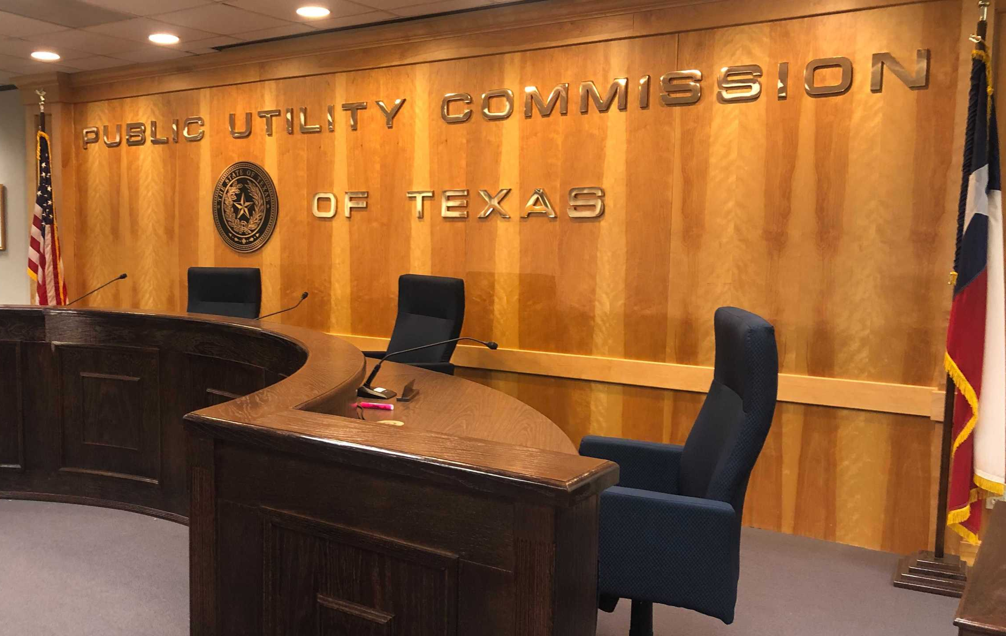
Chapter 2: From a Firm to the Public Sector
Sam decides to depart from New Law Firm, PC to the Public Utility Commission of Texas (PUCT).
He looks forward to gaining the public sector perspective of the matters he worked on at New Law Firm, PC.
Notes:
Sam decides to leave the New Law Firm for a legal role at the PUC.
And in accepting a legal role at the PUC he hopes to work on the opposite side of matters that he worked on while at New Law Firm.

Slide 19
Rule 1.09
(a) Without prior consent, a lawyer who personally has formerly represented a client in a matter shall not thereafter represent another person in a matter adverse to the former client:
  (1) in which such other person questions the validity of the lawyer's services or work product for the former client;
  (2) if the representation in reasonable probability will involve a violation of Rule 1.05; or
  (3) if it is the same or a substantially related matter.
Notes:
This Rule is primarily for the protection of clients and as seen with the “without prior consent” language, clients can waive these protections.
A waiver is effective only if there is consent after disclosure of the relevant circumstances, including the lawyer's past or intended role on behalf of each client, as appropriate.

Slide 20
Rule 1.10
(e) Except as law may otherwise expressly permit, a lawyer serving as a public officer or employee shall not:
  (1) Participate in a matter involving a private client when the lawyer had represented that client in the same matter while in private practice or nongovernmental employment, unless under applicable law no one is, or by lawful delegation may be, authorized to act in the lawyer's stead in the matter; or
  (2) Negotiate for private employment with any person who is involved as a party or as attorney for a party in a matter in which the lawyer is participating personally and substantially
Notes:
The Texas Center for Legal Ethics stated that this is the most important rule for government agency attorneys.
An attorney coming to the government from a private firm may not participate in a matter where the attorney represented the private client in the same matter.
So this allows government attorneys to participate in anything except matters in which they were directly involved.
As The first comment to this rule states, the intent of this rule is to “prevent a lawyer from exploiting public office for the advantage of a private client.” But also a public sector position should not be used to punish a client or get revenge for being a difficult client while at the law firm.

Slide 21
Rule 1.10
(f) As used in this rule, the term “matter” does not include regulation-making or rule-making proceedings or assignments, but includes:
  (1) Any adjudicatory proceeding, application, request for a ruling or other determination, contract, claim, controversy, investigation, charge accusation, arrest or other similar, particular transaction involving a specific party or parties; and
  (2) any other action or transaction covered by the conflict of interest rules of the appropriate government agency.
Notes:
Rule 1.10 goes on to specify the types of proceedings and actions that are included in the term ”matter”
Adjudicatory proceedings, applications, requests for rulings, investigations, and any transaction involving specific parties AND any other transaction covered by the conflict of interest rules of the agency

Slide 22
Chapter 2: From a Firm to the Public Sector [REVIEW]
Sam decides to depart from New Law Firm, PC to the Public Utility Commission of Texas (PUCT).
He looks forward to gaining the public sector perspective of the matters he worked on at New Law Firm, PC.
Notes:
So in reviewing these rules and Sam’s decision to depart new law firm. We don’t see a prohibition on him moving from the private sector to the PUC. That part is fine. The issue was his expectation to work on the opposite side of the matters that he worked on while at the law firm, so if he represented a specific utility and he wants to continue in the same docket, that would be prohibited, so maybe he can stay in the same sector, but working on the same docket that he worked on wall at new law firm would be prohibited by these rules.

Slide 23

Chapter 3: From the Public Sector to the Private Sector
Sam is preparing to leave the PUCT.
He believes that because he is coming from the public sector, there are no restrictions to his employment.
He also believes that because his work was subject to open records requests, he has no potential conflicts.

Slide 24
Standards of Conduct and Conflict of Interest Provisions under the Government Code
Sec. 572.051(a) A state officer or employee should not: …
(2) accept other employment or engage in a business or professional activity that the officer or employee might reasonably expect would require or induce the officer or employee to disclose confidential information acquired by reason of the official position;
(3) accept other employment or compensation that could reasonably be expected to impair the officer's or employee's independence of judgment in the performance of the officer's or employee's official duties; …
Notes:
Any lawyer violating this Subsection is subject to termination or another employment-related sanction. Additionally, the civil or criminal penalties may apply.
Concurrent Employment
Also of note, Chapter 36 of the penal code prevents public servants from accepting accepting a "benefit" in exchange for their decision, opinion, recommendation, vote, or other exercise of official discretion.
So it would be bribery if a state officer accepted other employment in exchange for official action or inaction.
In addition, under the honorarium law a state officer may not accept any fees or payments for performing services that he or she would not have been asked to provide but for his or her official status.

Slide 25
Future Employment Prohibitions
Three “Revolving Door” Restrictions
  Former State Officer or Employee of a State Agency: For two years after you cease to be a state officer or employee of an agency, you may not accept employment from a person if you participated on behalf of the state agency in a procurement or contract negotiation involving that person.
  Former Board Member Or Executive Director Of A Regulatory Agency: For two years after you cease to be a member of the board, you may not make any communication to or appearance before an officer or employee of the board on behalf of any person with the intent to influence agency action in connection with any matter on which that person seeks official action.
Notes:
Chapter 572 of the Government Code contains three "revolving door" provisions. Each provision applies to different groups of former officers and employees of state agencies.
Three “Revolving Door” Restrictions
Former State Officer or Employee of a State Agency: this says “participated” which would encompass any involvement by lawyers in drafting, negotiating, or approving any of these agreements.
Former Board Member Or Executive Director Of A Regulatory Agency: Prevents board members or executive directors from representing clients in front of the board that they departed for 2 years
https://www.ethics.state.tx.us/opinions/partVII/572.html

Slide 26
Future Employment Prohibitions (Cont.)
Three “Revolving Door” Restrictions
  Former Board Members and Executive Directors of Regulatory Agencies or Employees Compensated Above $36,976/year: may never represent a person or receive compensation for services rendered on behalf of any person regarding a “particular matter” in which he or she “participated” while serving with the agency.
    A “particular matter” is a specific matter before the agency, such as an investigation, application, contract, rulemaking proceeding, administrative proceeding, request for a ruling, etc.
    It does not prohibit you from working on the type of matters you worked on at the agency. This restriction lasts forever.
Notes:
Finally,
Former Board Members and Executive Directors of Regulatory Agencies or Employees Compensated Above $36,976/year: may never represent a person or receive compensation for services rendered on behalf of any person regarding a “particular matter” in which he or she “participated” while serving with the agency. A “particular matter” is a specific matter before the agency, such as an investigation, application, contract, rulemaking proceeding, administrative proceeding, request for a ruling, etc.
This revolving door provision prohibits you from representing a person, or getting paid to help a person, regarding a specific matter in which you were either personally involved or that was a matter within your official responsibility while a state officer or employee.
It does not prohibit you from working on the type of matters you worked on at the agency. Only prevents you from working on the exact matter that you worked on while you were at the agency.
This restriction lasts forever.

Slide 27
PURA Sec. 12.155
(a) A commissioner, a commission employee, or an employee of the State Office of Administrative Hearings involved in hearing utility cases may not:
  (1) be employed by a public utility that was in the scope of the commissioner's or employee's official responsibility while the commissioner or employee was associated with the commission or the State Office of Administrative Hearings; or
  (2) represent a person before the commission or State Office of Administrative Hearings or a court [for matters in which they were involved]
2 year prohibition for Commissioners; 1 year for commission and SOAH staff
Notes:
Similar to the revolving door statutes in the government code for state officers and employees of state agencies, PURA sec. 12.155 has prohibitions on employment and representation for commissioners, commission employees, or SOAH employees.
These individuals MAY NOT…
So following their last day of employment, THIS A 2 YEAR PROHIBITON FOR COMMISSIONERS AND A 1 YEAR PROHIBITION

Slide 28
Rule 1.05(b)(3)
(b)… a lawyer shall not knowingly:
  …
  (3) Use confidential information of a former client to the disadvantage of the former client after the representation is concluded unless the former client consents after consultation or the confidential information has become generally known.
Generally Known – “information that is actually known to some members of the general public and is not merely available to be known if members of the general public choose to look…”. E.O. 595 (February 2010).
Notes:
In an ethics opinion examining this rule, The Committee concluded that “generally known” refers to “information that is actually known to some members of the general public and is not merely available to be known if members of the general public choose to look where the information is to be found.”
In another opinion, the committee stated, “the fact that a public entity may engage with or discuss pending legal matters or advice with its lawyers in an open session of its governing body or that certain records pertaining to the public entity’s representation by its lawyers may be available through an open records request of that public entity does not make all the public entity’s client confidential information “generally known.” Some of the client confidential information in this public entity context may be “generally known” due to some members of the public attending these open sessions or from media accounts of the meetings; however, that fact does not make the entire body of client confidential information relating to the lawyer’s representation of the public entity “generally known.”
A public sector lawyer has a variety of communications that are not generally known which may include: discussion conducted during executive sessions or privileged communications and work product.

Slide 29
Chapter 3: From the Public Sector to the Private Sector [REVIEW]
Sam is preparing to leave the PUCT.
He believes that because he is coming from the public sector, there are no restrictions to his employment.
He also believes that because his work was subject to open records requests, he has no potential conflicts.

Slide 30
New Chapters Checklist
Review Partnership/Employment Agreement
Check for conflicts
Provide sufficient notice and information to employer & clients
Maintain and safeguard relevant client information
Prepare new legal services agreements

Slide 31
Thank You!
Good luck to you in your current and any future career chapters.

