Slide 1
The New Texas Business Court
 | Amy Prueger Sara Berkeley Churchin Chris Kirby | State Bar of Texas Public Utility Law Section May 17, 2024

Slide 2
Overview
Jurisdiction
Judicial Divisions
Judicial Appointments
Procedural Rules
15th Court of Appeals
Anticipated Challenges & Logistical Concerns
https://www.txcourts.gov/media/1441425/ajrs-04_25_18.pdf (last visited May 3, 2024).

Slide 3
Texas Gov’t Code Ch. 25A & Texas Rules of Jud. Admin.
Enables formation of 11 geographically-divided specialty trial courts for resolving certain types of complex business disputes
Effective date September 1, 2023; applicable only to actions commencing on or after September 1, 2024
Five divisions commence operations on Sept. 1, 2024; additional six divisions (including El Paso) will not open absent further legislative action to appropriate funding

Slide 4
Texas Gov’t Code Ch. 25A & Texas Rules of Jud. Admin.
Statute contains fifteen defined terms (plus subparts) including:
“controlling person”
“ownership interest”
“governing documents”
“managerial official”
“officer”
“internal affairs”
See Tex. Civ. Prac. & Rem. Code § 25A.001.

Slide 5
Concurrent Jurisdiction
The Texas Business Court shares concurrent civil jurisdiction with Texas District Courts in three general categories of controversies:

Slide 6
Concurrent Jurisdiction
Category 1:
$10 million+ in controversy plus enumerated action:
contract disputes, provided the parties agree to the Business Court’s jurisdiction;
(Note that amount in controversy excludes interest, statutory damages, penalties, attorney’s fees, and court costs)

Slide 7
Concurrent Jurisdiction
Category 1:
$10 million+ in controversy plus enumerated action:
contract disputes, provided the parties agree to the Business Court’s jurisdiction;
certain disputes brought under the Texas Finance & Business Codes “by an organization or an officer or governing person acting on behalf of an organization other than a bank, credit union, or savings and loan association.”

Slide 8
Concurrent Jurisdiction
Category 1:
$10 million+ in controversy plus enumerated action:
contract disputes, provided the parties agree to the Business Court’s jurisdiction;
certain disputes brought under the Texas Finance & Business Codes . . .
a “qualified transaction”

Slide 9
Concurrent Jurisdiction
“qualified transaction” (Rule 339(o)) -
a transaction, other than a transaction involving a loan or an advance of money or credit by a bank, credit union, or savings and loan institution under which a party:

Slide 10
Concurrent Jurisdiction
“qualified transaction” -
. . . under which a party:
pays or receives or is obligated to pay or is entitled to receive consideration with an aggregate value of at least $10 million; or
lends, advances, borrows, receives, is obligated to lend or advance, or is entitled to borrow or receive money or credit with an aggregate value of at least $10 million. (Rule 339(o)).

Slide 11
Concurrent Jurisdiction
Category 2:
$5 million+ amount in controversy plus actions that involve corporate disputes
e.g., governance, derivatives, securities claims
Category 3:
corporate disputes of any value if one party is publicly traded

Slide 12
Concurrent Jurisdiction
Excluded disputes include:
probate law
family law
DTPA/consumer complaints
insurance, injury, death, or medical/ legal malpractice
matters brought by or against governmental entities

Slide 13
Supplemental Jurisdiction
supplemental jurisdiction “over any other claim related to a case or controversy within the court’s jurisdiction that forms part of the same case or controversy.”
claim proceeds in the Business Court only upon agreement of all parties and a Business Court judge of the division of the court where action is pending
If no agreement, claim proceeds in a court of original jurisdiction concurrently with any related claims proceeding in the Business Court

Slide 14
Judicial Divisions
Eleven geographical divisions align with the current Administrative Regions for Texas Appellate Courts →
Five largest urban divisions commence operations in 2024 and will have two judges:
Austin, Dallas, Fort Worth, Houston & San Antonio
https://www.txcourts.gov/media/1441425/ajrs-04_25_18.pdf (last visited May 3, 2024)

Slide 15
Judicial Divisions
Operations in remaining six divisions conditioned on passage of new appropriations and funding during the 2025 legislative session
These rural divisions will have only one judge
https://www.txcourts.gov/media/1441425/ajrs-04_25_18.pdf (last visited August 29, 2023)

Slide 16
Judicial Appointments
As of Sept. 1, 2023, Governor Greg Abbott began accepting applications for the ten judges he will appoint to preside over Dallas, Austin, San Antonio, Houston, and Fort Worth divisions
Appointments are subject to Senate approval
Up to sixteen judges will serve a two-year term and be eligible for reappointment

Slide 17
Judicial Appointments
Qualifications: at least 35 years old; U.S. citizen; resident of county within division for at least five years; licensed to practice law in Texas; at least 10 years experience in
(1) complex commercial litigation,
(2) business transactions law, or
(3) service as a Texas civil court judge.

Slide 18
Judicial Authority
on matters over which the Business Court has statutory jurisdiction, Business Court judges may provide injunctive, mandamus, garnishment, and any other relief that a district court may grant

Slide 19
Right to Jury Trial (Rule 342)
A party in an action pending in the Business Court possesses the right to a jury trial “when required by the constitution.”
The drawing of jury panels, selection of jurors, and other jury-related practice/procedure will be the same as in district court in same county

Slide 20
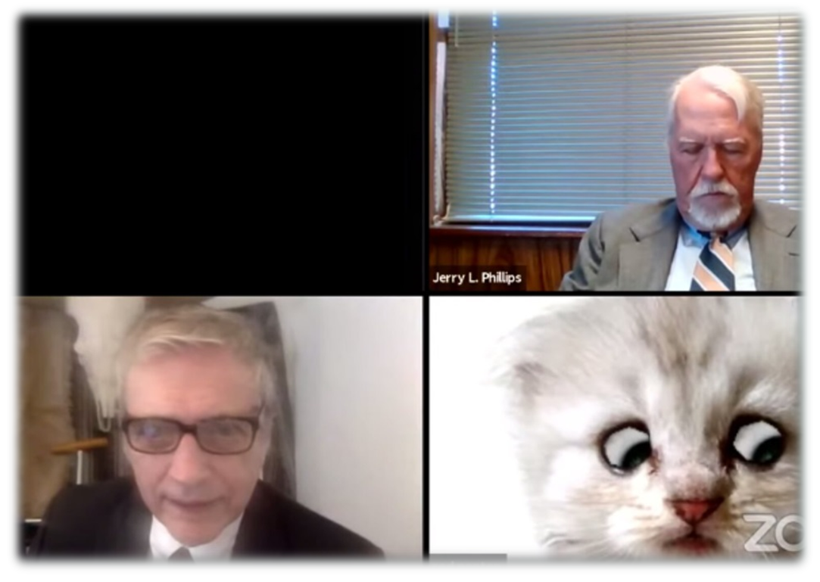
Remote proceedings permitted, except for jury trials
Unless the parties agree, the Business Court may not require a party/attorney to remotely attend proceeding in which oral testimony heard.
Remote Proceedings

Slide 21
Tasks Assigned to SCOTX – Step One: Supreme Court Advisory Committee (SCAC)
Rules on written opinions
balancing benefits with judicial efficiency
Rules on fees
the Business Court is self-funded
Rules on removal and remand
modeled after FRCP? MDL?
heightened pleading standard?
assignment of cases to judges
assignment of visiting judges
SCAC submitted Proposed Rules on October 13, 2023
SCAC postponed setting fees
Section 25A.20

Slide 22
SCOTX Rulemaking -
SCAC
SCAC made final recommendations to SCOTX (Oct. 2023)
SCOTX
Study/discussion
Preliminary order issued on Feb. 6, 2024
Revisions and final order (summer 2024)
Effective Sept. 1, 2024
Business Court Subcommittee proposals and discussions (June, Aug., Oct. 2023)
Public-comment period ended May 1, 2024

Slide 23
SCOTX’s Preliminary Approval of Rules for Bus. Courts (Misc. Docket No. 24-9004)
What governs?
TRCP governs procedures (new TCRP 352-359)
Rules on fees
Office of Court Administration to publish fee schedule (SCAC deferred for lack of data)
Written opinions
Required “in connection with a dispositive ruling”/ request of “a party”/issue important to state’s jurisprudence (regardless of request)
See also Tex. Gov’t Code Ch. 25A, parts I, II, III, VI
Bus. Ct. must waive fees for inability to afford payment of costs (Rule 145); may waive fees “in the interest of justice”
Permitted “in connection with any order”
(part III controls conflicts)

Slide 24
SCOTX’s Preliminary Approval of Rules for Bus. Courts (Misc. Docket No. 24-9004)
Pleading Standards
TRCP Rule 354
original petition “must also plead facts to establish venue in a county in an operating division of the business court.”
originally filed actions (petition/counterclaim/cross-claim, third-party claim) “must, in addition to pleading requirements specified in Part II, plead facts to establish the business court’s authority to hear the action.”

Slide 25
SCOTX’s Preliminary Approval of Rules for Bus. Courts (Misc. Docket No. 24-9004)
Asserting Venue & “Authority” Challenges
TRCP 354
Venue Challenges: must comply with Rules 86 & 87
Authority Challenges – motion challenging “the business court’s authority to hear an action must be filed within 30 days of movant’s appearance.”

Slide 26
SCOTX’s Preliminary Approval of Rules for Bus. Courts (Misc. Docket No. 24-9004)
Resolving Venue & “Authority” Challenges
Venue Challenges - if business court determines upon motion that its geographic territory does not include a county of proper venue, court must: (A) transfer to operating division of the court that includes county of proper venue or (B) if no operating division of proper venue, at the filing party’s request, transfer to a district court or county court in county of proper venue.
Authority Challenges – if business court determines that it lacks authority to hear the action
(A) if on court’s own initiative, must provide 10 days’ notice of intent to transfer or dismiss & provide an opportunity to hear objections; and
(B) if on party request, transfer action to district court/county court in county of proper venue or dismiss the action without prejudice to parties’ claims.

Slide 27
SCOTX’s Preliminary Approval of Rules for Bus. Courts (Misc. Docket No. 24-9004)
Removal
TRCP 355
Removal: party to action originally filed in district ct./county ct. may remove by filing notice of removal with court from which removal is sought & business court
notice must state whether all parties agree; plead facts to establish authority & venue; contain copy of docket sheet and all “process, pleadings, and orders in the action.”

Slide 28
SCOTX’s Preliminary Approval of Rules for Bus. Courts (Misc. Docket No. 24-9004)
Removal
TRCP 355
Deadlines -
When agreed: “at any time during the pendency of the action”
When not agreed: notice of removal must be filed
within 30 days after the date the party requesting removal of the action discovered, or reasonably should have discovered, facts establishing the business court’s authority to hear the action; or
if an application for temporary injunction is pending on date that party requesting removal discovers facts under subsection A, above, within 30 days after the date the application is granted/denied/denied by operation of law.
Notice of removal to business court is not subject to due order of pleadings (doesn’t waive venue challenge/constitute personal appearance for purposes of waiving personal jurisdiction challenge)

Slide 29
SCOTX’s Preliminary Approval of Rules for Bus. Courts (Misc. Docket No. 24-9004)
Remand
Remand required if business court determines, on motion or initiative, that removal was improper; action remanded to court from which it was removed. Court must provide 10 days’ notice and opportunity to hear objections
Motion to remand for improper removal within 30 days after notice of removal is filed; but, if party served with process after notice of removal filed, motion to remand due 30 days after the party enters an appearance.

Slide 30
SCOTX’s Preliminary Approval of Rules for Bus. Courts (Misc. Docket No. 24-9004)
Transfer
TRCP 356
Action Transferred to Business Court
(a) court may on its own initiative request the presiding judge for administrative judicial region where court is located transfer an action pending in the court to business court if the business court has authority to hear action. “Regional presiding judge” = presiding judge for administrative judicial region in which court is located
(b) notice & hearing required upon objection; hearing coordinated with regional presiding judge, who self assigns to the court/conduct a hearing/rule on request

Slide 31
SCOTX’s Preliminary Approval of Rules for Bus. Courts (Misc. Docket No. 24-9004)
Transfer & Remand
TRCP 356
Action Transferred to Business Court
(c) Regional presiding judge may transfer action to business court if he/she finds the transfer will facilitate the fair & efficient administration of justice. Denials of motion to transfer challenged by writ of mandamus *in court of appeals district for the requesting court’s county*
(d) Remand from business court sought under Rule 355; within 30 days after case is transferred
(e) Business court clerk must assign action to appropriate operating division; if more than one judge in that division, clerk must “randomly assign the action” to specific judge.

Slide 32
SCOTX’s Preliminary Approval of Rules for Bus. Courts (Misc. Docket No. 24-9004)
Effect of Dismissal/limitations tolled
TRCP 357
If business court dismisses an action or claim and same action/claim is filed in a different court within 60 days after dismissal becomes final, the applicable statute of limitations is suspended for the period between the filings

Slide 33
15th Court of Appeals
“Notwithstanding any other law and except... when the supreme court has concurrent or exclusive jurisdiction, the Fifteenth Court of Appeals has exclusive jurisdiction over an appeal from an order or judgment of the business court or an original proceeding related to an action or order of the business court.” (emphasis added)

Slide 34
15th Court of Appeals
The 15th Court’s district extends to all counties in Texas:
“The Court of Appeals for the Fifteenth Court . . . shall be held in the City of Austin” but “may transact its business in any county in the district as the court determines is necessary and convenient.”

Slide 35
15th Court of Appeals
Court has civil jurisdiction over:
matters brought by or against the state (with many statutory exceptions; e.g., cases brought under the Family Code, personal injury claims, employment discrimination etc.);
Challenges to the constitutionality or validity of a state statute or rule

Slide 36
15th Court of Appeals
For first three years, court will consist of one chief justice and two additional judges—same panel will hear all appeals
In 2027 will increase to one chief justice and four additional justices

Slide 37
15th Court of Appeals
Justices will be appointed by the governor for a six-year term and thereafter will run for statewide election
Unlike business-court judicial appointments, the statute requires no minimum business-experience qualifications for 15th Court justices

Slide 38
Anticipated Challenges
statute requires any challenge to proceed directly to the Texas Supreme Court (has exclusive jurisdiction)
If appointment process fails such challenge, certain criteria will ensure elected judges meet statutory qualifications

Slide 39
Logistical Concerns
no existing infrastructure -
needs a case management system, supplies, furniture, technology, etc.

Slide 40
Logistical Concerns
Appointments and staff hires (40 full-time employees?)
issues related to security, staffing, and personnel

Slide 41
SCAC Meetings & Comments
Transcripts of committee meetings available at: https://www.txcourts.gov/scac/meetings/2021-2030/
limited public comments include concerns about rules limiting remote proceedings; preference for “common law courts”
Concerns raised by Chief Justice Tracy Christopher re: 15th COA

Slide 42
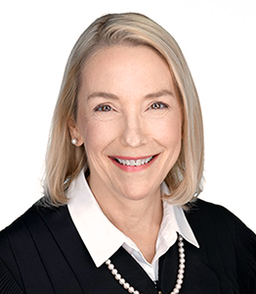
Chief Justice Christopher (14th Court) Public Comment re: logistics of transferring cases:
Does the district court make the transfer to the 15th COA or does original COA make the transfer? Need for comment in rules.
If original COA handles transfer, it must have sufficient information for making that determination: “At a minimum, . . . the appealing party [should] state in the notice of appeal that the case should or should not transfer to the 15th.”
Does the entire case transfer to the 15th COA, such as in “a multi-party case where only one party’s case belongs in the 15th? Should we transfer the entire case to the 15th court when one cause of action belongs in the 15th and one cause of action is excluded (example–breach of contract and wrongful termination)?”

Slide 43
Questions?

Slide 44
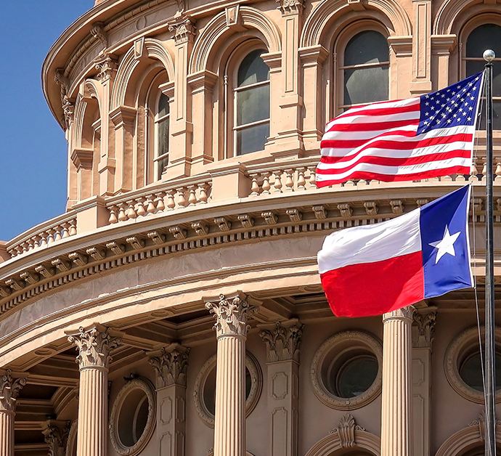
Thank you!

